Slide 1
CSC 179
Summer 2022
User Story Based-Testing
Red Shift
Team Members: Santiago Bermudez, Sabeeha Baqui, Steven Graham, Hardev Singh, Ivan Gutierrez, Eric Truong, Alex Tran
Presentation Date: 06/22/2022

Slide 2
Overview
The app was developed using a wide variety of technologies including React JS for Frontend, Vendia for Backend, Visual Studio Code (VS Code), andJavascript.
Our team used GitHub, Discord, and Google Docs to communicate with one another and keep each other updated about our overall and individual progress.
User story based testing allows a developer to test all possible aspects of the application and ensure that no potential bugs/fixes fall through.
It allows a developer to look at an application/product from a customer’s perspective and make fixes accordingly.
User Story Based testing may be used at any stage in testing due to User Stories / Acceptance Criteria being less specific.

Slide 3
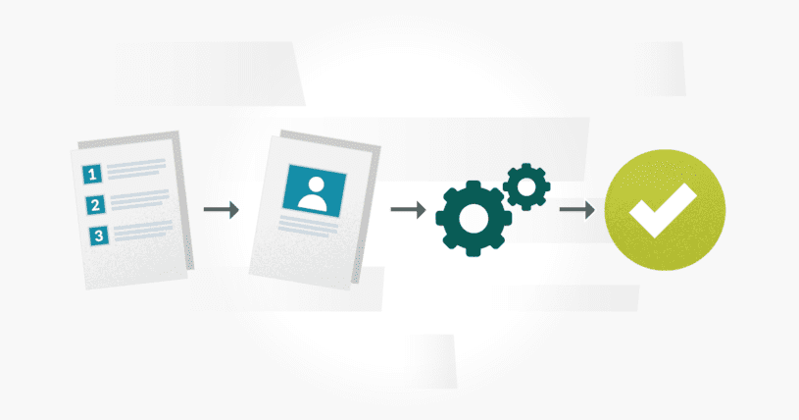
Background
Developed utilizing a myriad of technologies.
React JS for Frontend
Vendia for Backend
Visual Studio Code (VS Code)
Javascript
GitHub for Version Control & Collaboration
Discord for Communication
Google Docs for Deliverables, Test Planning, and Project Presentation
User story based testing is an informal, general explanation of a software feature written from the perspective of the end user. Its purpose is to demonstrate how a software feature will provide value to the customer. Our goal is to see if previously detected problems have been corrected and if any new potential problems may be found. User based stories help us provide an important framework which helps drive for a better overall product design.

Slide 4
Applicability - When to Use
It is best used before any developer testing / development because it allows the producers and other teams a chance to go over which features are going to be implemented or fixed.
This ensures that everyone comes to an agreement on the product before work is done.
We want to know what needs to be worked on first so no time is wasted. Mostly every project has a due date and being able to manage time can lead to saving budget.
User Story Based testing may be used at any stage in testing due to User Stories / Acceptance Criteria being less specific.

Slide 5
Applicability - How to Use
We write a User Story for a feature to be created or updated. Then we will write a few acceptance criteria for this User Story.
Acceptance Criteria are specific cases based on a User Story
As a user
I want to be able to share personal details about myself with another user
So that I can try and negotiate better health plans
User presses share details on their page
They search for another user (or use email) to share it to
They confirm the share.
The user will have successfully shared their details
User Stories and Acceptance Criteria can be the basis for brainstorming test cases.
It makes you see in the eyes of a consumer thinking about limit testing our application.

Slide 6
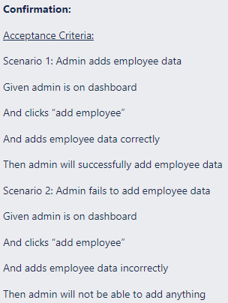
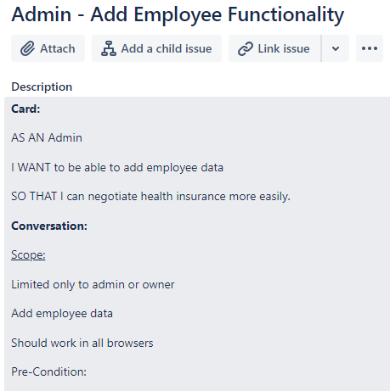
Explanation & Demo, Example 1
https://docs.google.com/document/d/1yiCnR5De9CQ741ctJf4X7rNpM_uVQIm1N46zMWofnNI/edit?usp=sharing

Slide 7
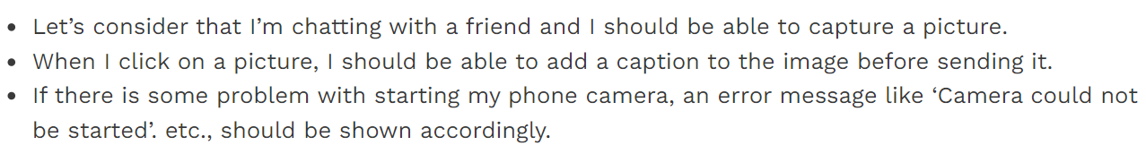
Explanation & Demo, Example 2
https://docs.google.com/document/d/1yiCnR5De9CQ741ctJf4X7rNpM_uVQIm1N46zMWofnNI/edit?usp=sharing

Slide 8
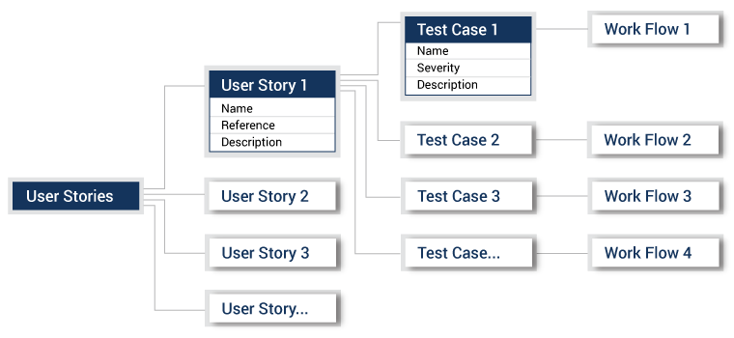
Advantages / Benefits
Some advantages and benefits of user story-based testing include..
High value delivery - taking a task or specific need and breaking it down into smaller parts and prioritizing them, could be used on specifically testing to get a very specific results and making sure there are no faults in that test or delivery
Reduces risk - with user stories team members share a greater understanding of the team goals so there is little to no lack of communication, financial, or business risk
Improves transparency - transparency and can greatly boost collaboration between group members

Slide 9
Drawbacks / Issues
There is less focus on Non-Functional requirements such as:
Performance
Fault Tolerance
Usability
It is difficult to scale for larger projects
User stories are simple formats
User stories may be too vague to understand what the requirements are.
Example: “I would like a button so i can share the document with my friends.” Is it share by email, file transfer, sms, facebook, instagram?
Most of the drawbacks can be prevented by proper training in writing user stories and learning how to make sure you understand what the client wants.

Slide 10
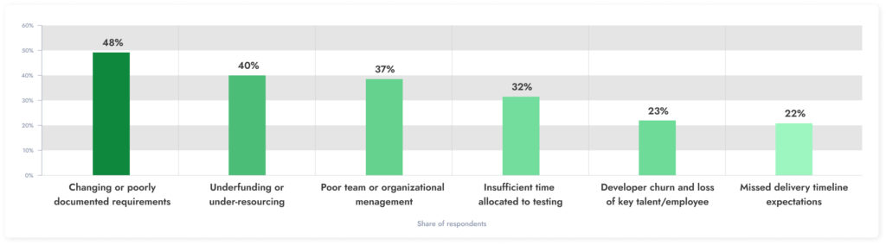
Team’s take away & Critique
*It doesn’t say on this image but this was from an article published in Statista in 2015.

Slide 11
Team’s take away & Critique pt.2
User stories can be tricky to write well
Complex/detailed analysis needs to be conducted before writing stories
Emphasis on user stories being written well, in a clear and concise manner
Simplifies requirements definition
Great way to streamline requirements and structure
Easy prioritization to make small steps within the project that are easy to follow

Slide 12
References
https://blog.qasource.com/software-development-and-qa-tips/how-do-you-convert-user-stories-into-test-cases
https://blog.testlodge.com/writing-test-cases-from-user-stories-acceptance-criteria/#:~:text=%20Here%20are%20some%20examples%20that%20come%20to,occurs%3F%20Create%20a%20test%20case%20to...%20More%20
https://www.softwaretestinghelp.com/user-story-acceptance-criteria/
What is User Story and Acceptance Criteria (Examples) (softwaretestinghelp.com)
https://airfocus.com/glossary/what-is-a-user-story/#:~:text=Disadvantages%20of%20using%20user%20stories,-These%20are%20some&text=The%20non%2Dfunctional%20requirements%20such,the%20typical%20user%20story%20templates.
https://www.statista.com/statistics/627648/worldwide-software-developer-survey-project-failure/
https://jadealm.com/blog/why-do-software-projects-fail-5-biggest-reasons/
https://agileforgrowth.com/blog/userstory-benefits/

